Slide 1
Oracle Forms – New Development & Modifications

Slide 2
What to Expect from the session
After the session there will be clear understanding of below mentioned topics
1. Develop New Forms - Simple & Medium - (Oracle Forms)
2. Modify Existing Oracle Forms / Custom.pll / TEMPLATE.fmb
3. Forms Personalization
4. Forms Debugging
5. Code Packaging & Deployment
6. Walkthrough of MD050, MD070 and MD120

Slide 3
Forms Development Overview
After completing this lesson, you should be able to do the following:
Define grid computing
Explain how Oracle 10g products implement grid computing
Describe the components of Oracle Application Server 10g and Oracle Developer Suite 10g
Describe the features and benefits of Oracle Forms Services and Oracle Forms Developer
Describe the architecture of Oracle Forms Services
Describe the course application

Slide 4
Internet Computing Solutions
Application Type
and Audience
Product
Approach
Oracle
Products
Enterprise applications,
Business developers
Repository-based
modeling & generation,
Declarative
Oracle Designer,
Oracle Forms Developer, & Oracle Forms Services
Java components,
Component developers
Two-way coding,
Java and JavaBeans
Oracle JDeveloper
Oracle Application Server 10g
Self-service applications &
content management,
Web site developers
Browser-based,
Dynamic HTML
Oracle Portal
Oracle Database Server
Reporting and analytical applications,
MIS & business users
Dynamic Web reporting, Drill, Analyzing, Forecasting
Oracle Reports Developer,
Oracle Reports Services,
Oracle Discoverer, &
Oracle Express

Slide 5
Plugging into the Grid
Grid computing is:
a computer network in which each computer's resourcesare shared with every other computer in the system. Processing power, memory and data storage are all community resources that authorized users can tap into and leverage for specific tasks. A grid computing system can be as simple as a collection of similar computers running on the same operating system or as complex as inter-networked systems comprised of every computer platform you can think of.
Software infrastructure that uses low-cost servers and modular storage to:
Balance workloads
Provide capacity on demand
Made possible by innovations in hardware
Notes:
grid computing is a computer network in which each computer's resourcesare shared with every other computer in the system. Processing power, memory and data storage are all community resources that authorized users can tap into and leverage for specific tasks. A grid computing system can be as simple as a collection of similar computers running on the same operating system or as complex as inter-networked systems comprised of every computer platform you can think of.

Slide 6

Oracle Enterprise Grid Computing
Oracle's grid infrastructure products:
Oracle Database 10g
Oracle Application Server 10g
Oracle Enterprise Manager 10g Grid Control

Slide 7



Oracle 10g Products and Forms Development
Forms Services
Forms Developer

Slide 8
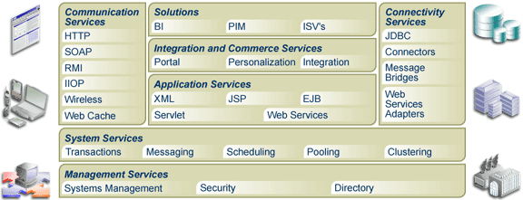
Oracle Application Server 10g Architecture

Slide 9



Oracle Forms Services Overview
A component of Oracle Application Server that deploys Forms applications to Java clients in a Web environment
Oracle Application Server Forms Services

Slide 10


Forms Services Architecture
Middle Tier: Application Server
Client Tier
Database Tier
Forms Listener
Servlet
Forms Servlet
Incrementally downloaded
Forms Runtime
User interface layer
Net Services
DB
Application logic layer
Data manager/ PL/SQL engine
JRE
Java applet
File containing application code

Slide 11
Benefits and Components of Oracle Developer Suite 10g
Application Development
OWB
Discoverer
Reports
JDeveloper
Forms
Designer
SCM
Business Intelligence

Slide 12
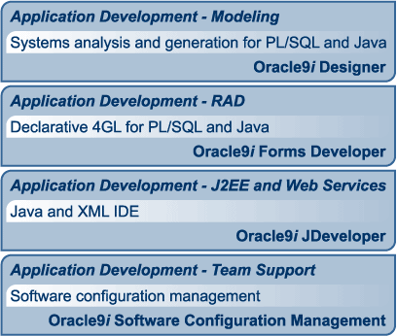
Oracle Developer Suite 10g Application Development

Slide 13
Oracle Forms Developer Overview
Oracle Forms Developer:
Is a productive development environment for Internet business applications
Provides for:
Data entry
Queries

Slide 14
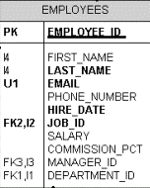

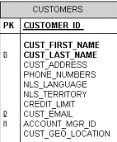
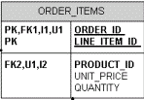
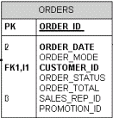
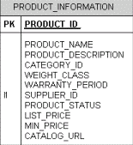
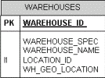

Example - Summit Office Supply Schema
Order Entry
Application

Slide 15
Example - Summit Application
CV_Customer Canvas
CUSTOMERS
Table
Customers
Form
CUSTOMERS Block
CV_Order Canvas
ORDERS
Table
ORDERS Block
Orders Form
ORDER_ITEMS
Table
ORDER_ITEMS Block
CV_Inventory Canvas
INVENTORIES Block
INVENTORIES
Table

Slide 16
Modify existing forms and forms debugging
Oracle Forms .fmb files are provided for Oracle E-Business Suite products. All Oracle E-Business Suite forms are located in the $AU_TOP/forms/<language> directory.
Copy the Oracle E-Business Suite form to a custom application for modifications. Follow these steps, using Oracle Forms Developer and Oracle Application Object Library, to modify a form:
Identify the file
Copy the file to a custom application and rename the file
Preserve the original file
Make the modifications
Comment the form
Generate the form
Document your customization

Slide 17
Forms Personalization
Oracle Supports personalization unlike customization
Personalization's are stored in tables rather than files
Will not have a bigger impact when you upgrade or apply patches to the environment
Can be moved easily through FNDLOAD from one instance to other
Can be restricted at site/responsibility/user level
Easy to disable/enable with click of a button.
Personalization will store who columns with which we have the ability to track who created/modified it where as in CUSTOM.PLL we don’t have that ability.
Can be applied to new responsibilities/users easily.
Can be restricted to function or form.

Slide 18
Forms Personalization (Cont.)
What can be done through personalization?
Zoom from one form to another
Pass data from one form to another through global variables
Change LOV values dynamically
Enable/Disable/Hide fields dynamically
Display user friendly messages when required
Launch URL directly from oracle form
Execute PL/SQL programs through FORM_DDL package
Call custom libraries dynamically

Slide 19
Summary
In this lesson, you should have learned that:
Grid computing makes computing power available without regard to its source
Oracle 10g products provide the software to implement enterprise grid computing
Oracle Application Server 10g provides services for building and deploying Web applications
Oracle Developer Suite 10g includes components for application development and business intelligence

Slide 20
Summary
Benefits of Oracle Forms Services include:
Optimized Web deployment of Forms applications
Rich Java UI without Java coding
Generic Java applet to deploy any Forms application
Oracle Forms Services consists of the Forms client, the Forms Servlet, the Forms Listener Servlet, and the Forms Runtime Engine.
Benefits of Oracle Forms Developer include rapid application development, application partitioning, flexible source control, extended scalability, and object reuse.
The course application is a customer and order entry application for Summit Office Supply.

Slide 21
Questions and Answers

